Slide 1


F I N A L Y E A R P R O J E C T P R E S E N T A I O N
IoT based smart health monitoring system
Department: B.Sc.- IT-Cloud Technology and Information Security
TECHNO INDIA UNIVERSITY
Presented by:
Ashaduzzaman Mondal (201001112006)
Rahul Upadhyay (201001112002)

Slide 2
T A B L E O F C O N T E N T
01 Abstract
02 Motivation
03 Introduction
04 Requirements
05 Features
06 Till now status of project
07 Remaining part of the project
08 Reference

Slide 3
A B S T R A C T
Our Health Monitoring App is a mobile application designed to help users manage and monitor their health using their mobile devices. The app provides a range of features, including health monitor, appointment booking, user authentication, multi-role based user access and real-time notifications. The app prioritizes user data privacy and security by implementing secure user authentication, and data backups.

Slide 4
M O T I V A T I O N
Our motivation for developing this Health Monitoring App was to provide a solution for individuals who are looking for an easy and accessible way to manage and monitor their health using their mobile devices. We recognized the need for a comprehensive health management tool that could offer real-time insights into users' health data, while also prioritizing user data privacy and security.
By developing this app, we aimed to provide users with a platform that empowers them to take control of their health and make informed decisions about their well-being. We also aimed to provide user access to apoint best doctor for them at low cost, also they can consult to doctor through our application.

Slide 5
I N T R O D U C T I O N
Our Health Monitoring App project is designed to help individuals monitor and manage their health using their mobile devices. Our app is built using React Native,Node.js and MongoDB and is intended for use by people of all ages and health conditions.
The Health Monitoring App is designed to make health monitoring easy, accessible, and convenient. Users can track their health status, record symptoms, view trends, and receive personalized recommendations for improving their health. The app is also designed to support collaboration between users and their healthcare providers, with features that allow users to securely share health data with their providers.

Slide 6
R E Q U I R E M E N T S
System Requirement:
PC with any Operating System
Minimum of 8gb RAM
Technology Requirement:
Node.js
React Native
React.js
Tailwind
Bootstrap
MongoDB
Nodemailer
Tools Requirement:
VS code
Android Studio

Slide 7
F E A T U R E S
Health data monitoring
Alert System
Appointment booking
User Authentication and Authorization
Multi-Role Based User Access
Real-time Notifications
Data Visualization
Cloud Data Storage
Integration with Wearable Devices

Slide 8
B L O C K D I A G R A M
Patient app
Welcome screen
Login
Home
Signup
Doctors
Profile
My watch
OTP
verification
Book appointment
Edit profile
Redirect to Login

Slide 9
B L O C K D I A G R A M
Doctor app
All appointment
Welcome screen
Login
Home
Profile
Edit profile

Slide 10
B L O C K D I A G R A M
Admin
All appointment
All
Doctors
Login
Home
All Patients
Add Doctor

Slide 11


B A C K E N D
Patient APIs:
Create account - /api/patient/create
Sign in - /api/patient/signin
Email verification - /api/patient/verify-email
Forgot password - /api/patient/forgot-password
Reset password - /api/patient/reset-password
Verify token - /api/patient/verify-token
Get user- /api/patient/get-user
Update details - /api/patient/update-details

Slide 12
T I L L N O W S T A T U S O F P R O J E C T
Backend:
Authentication API
Realtime Database API
Frontend:
Welcome Screen
Sign In Screen
Sign Up Screen

Slide 13
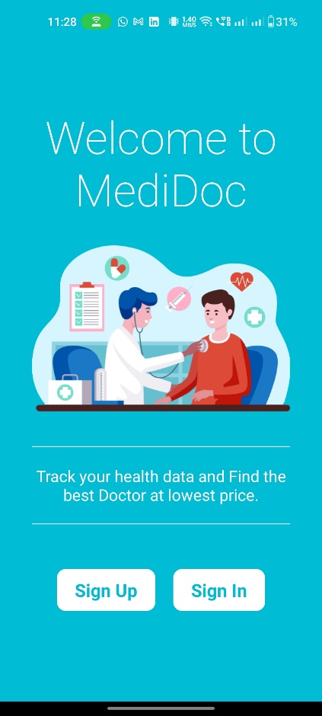
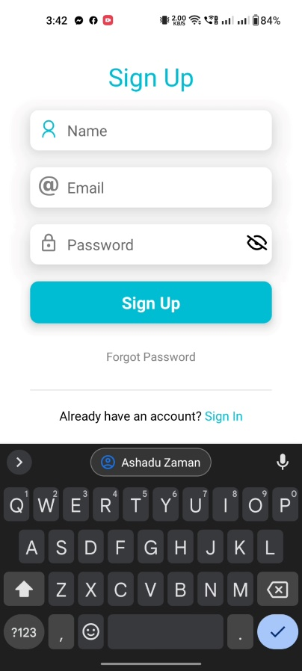
T I L L N O W S T A T U S O F P R O J E C T
UI Part:

Slide 14
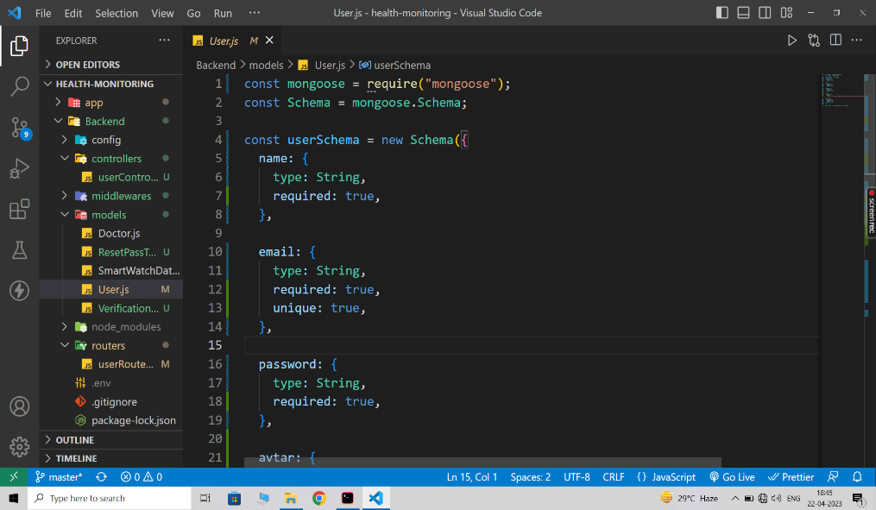
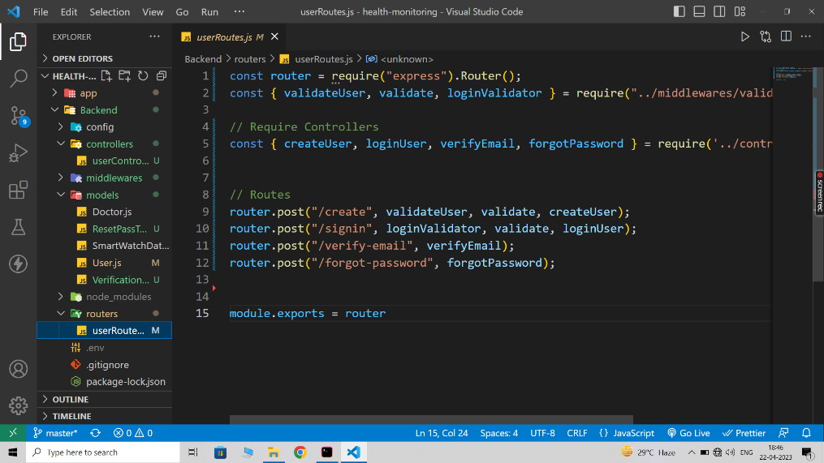
T I L L N O W S T A T U S O F P R O J E C T
Backend Part:
User Schema
Auth Route

Slide 15
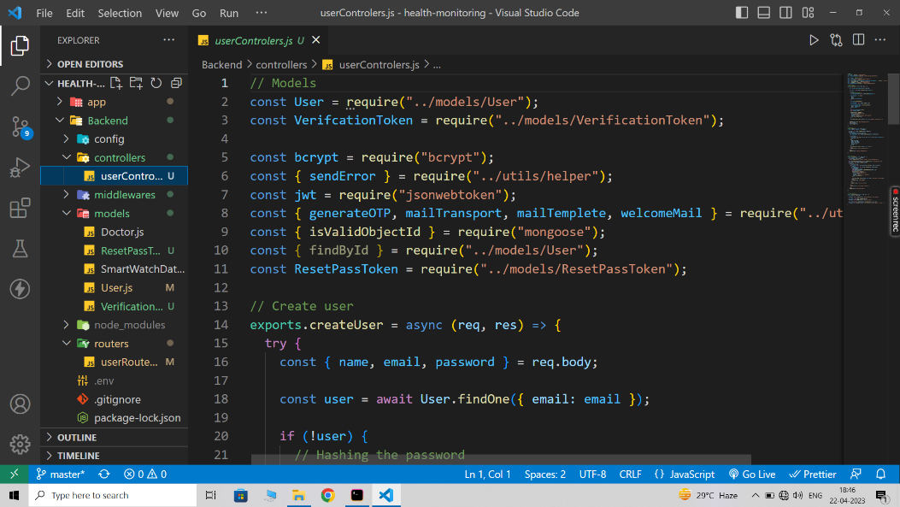
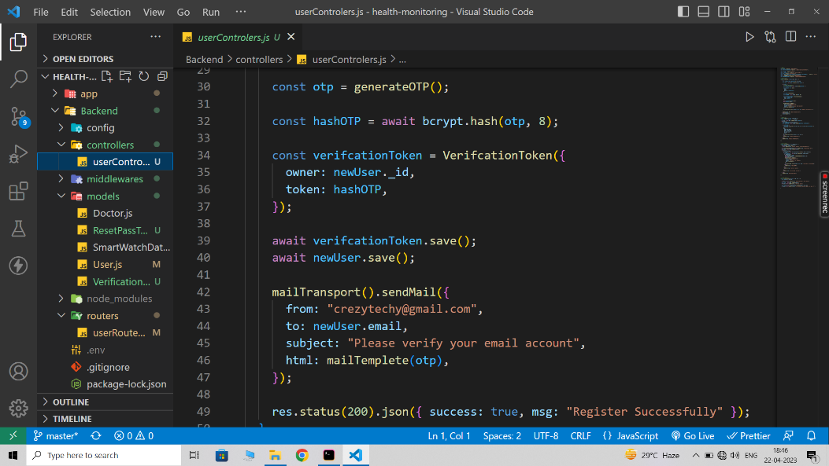
T I L L N O W S T A T U S O F P R O J E C T
Backend Part:
Require Dependencies
Sign Up Function

Slide 16
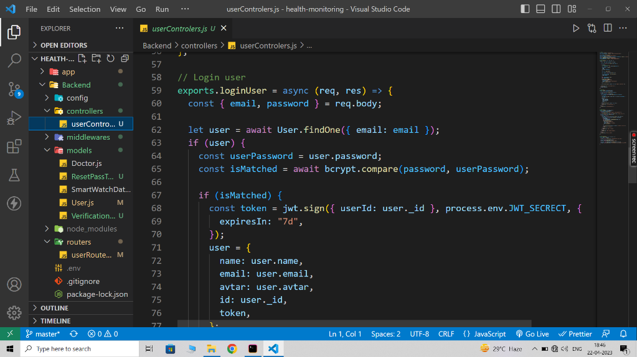
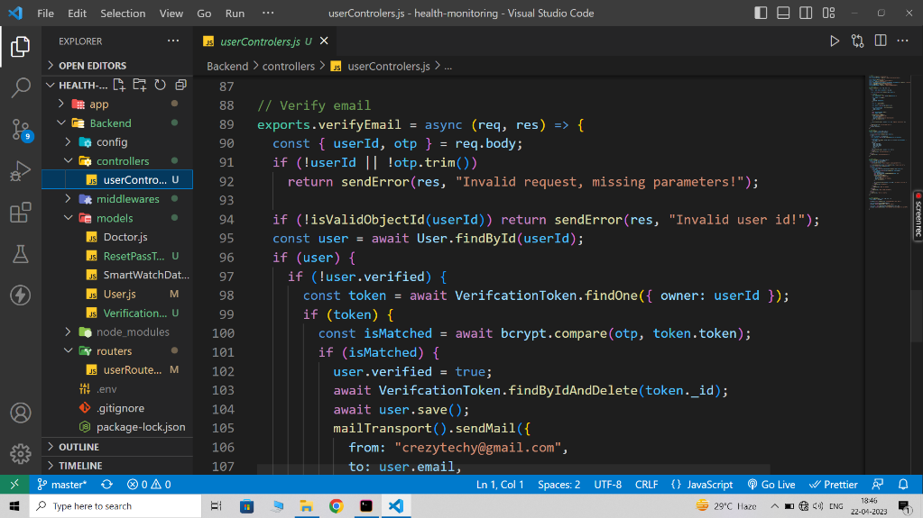
T I L L N O W S T A T U S O F P R O J E C T
Backend Part:
Login Function
Verification Function

Slide 17
R E M A I N I N G P A R T
Role-based Access Control System
Wearable Device Integration
Data Analysis and Visualization
Privacy and Security
Messaging and Collaboration
Testing and Debugging
We wish our full Application will be complet within 7 to 10 days

Slide 18
R E F E R E N C E S
React Native Documentation. Retrieved from https://reactnative.dev/docs/getting-started
Node.js Documentation. Retrieved from https://nodejs.org/en/docs/
Twilio API documentation: https://www.twilio.com/docs/usage/api
Fitbit API documentation: https://dev.fitbit.com/docs/
Data visualization libraries: D3.js (https://d3js.org/), Chart.js (https://www.chartjs.org/)

Slide 19
Thank you!

